Slide 1
SALES PERFORMANCE ANALYSIS AND REVENUE OPTIMIZATION USING DATA ANALYTICS
PROJECT PRESENTATION
Presented By
Apakama Ugochukwu Chimamkpam
AT AICIC Concepts Limited
Department of Data Analysis
IT Training Project

Slide 2
INTRODUCTION
Sales data contains valuable information about business performance.
Analyzing sales data helps identify trends, top-selling products revenue patterns.
This project uses data analytics tools to examine Nigerian e-commerce sales data.
The goal is to generate useful insights that can support better business decisions.

Slide 3
AIM AND OBJECTIVES
Aim:
To analyze sales data and identify useful insights that can help improve business performance and revenue.
Objectives:
Clean and prepare the sales dataset using Microsoft Excel.
Store and analyze the data using SQL Server.
Identify sales trends, top products and vendor performance.
Create interactive visual reports using Power BI
Provide recommendations based on the analysis.

Slide 4
DATASET AND TOOLS USED
Dataset:
Source: Kaggle – Nigerian E-Commerce Dataset
Period covered: February – May 2021
Records imported: 3,928
Focus: Delivered sales transactions
Tools Used:
Microsoft Excel: Data cleaning and preparation.
SQL Server Management Studio (SSMS): Database storage and analysis.
Power BI: Data visualization and dashboard development.

Slide 5
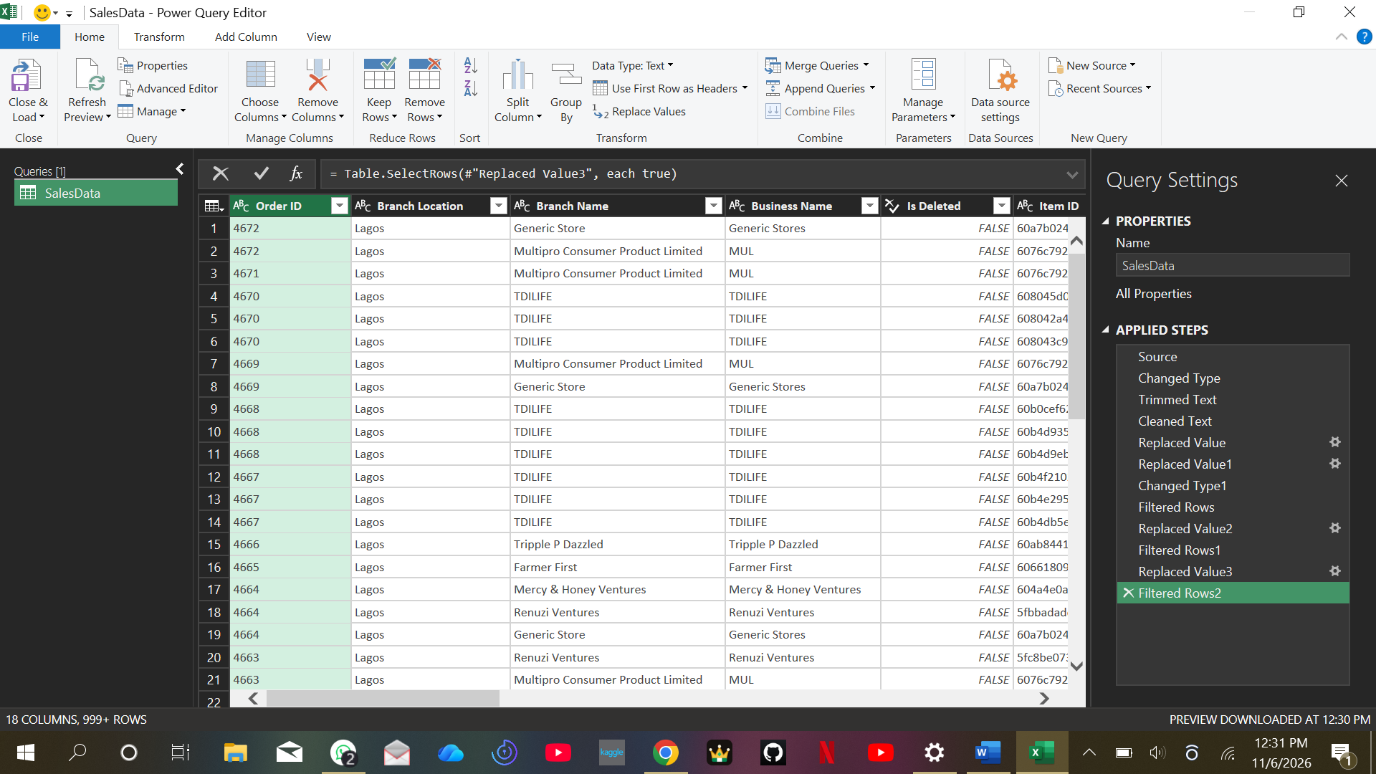
DATA CLEANING AND PREPARATION
Imported the Nigerian E-Commerce dataset into Microsoft Excel.
Used Power Query to clean and transform the dataset.
Handled missing values and corrected data inconsistencies.
Checked important columns such as Quantity, Item Name and Total Price.
Focused the analysis on delivered transactions.
Saved the cleaned dataset for SQL Server import.

Slide 6
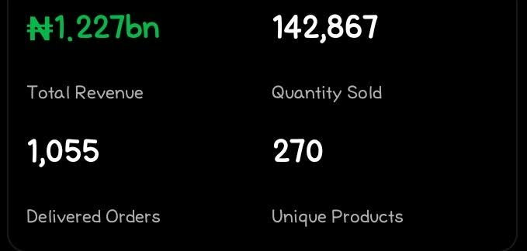
DATABASE MANAGEMENT AND SQL ANALYSIS
Created a database named SalesPerformanceDB.
Imported the cleaned dataset into SQL Server.
Stored 3,928 records in the SalesData_Cleaned table.
Used SQL queries to analyse:
Total revenue and quantity sold.
Monthly sales performance.
Top-performing products.
Vendor and branch performance.

Slide 7
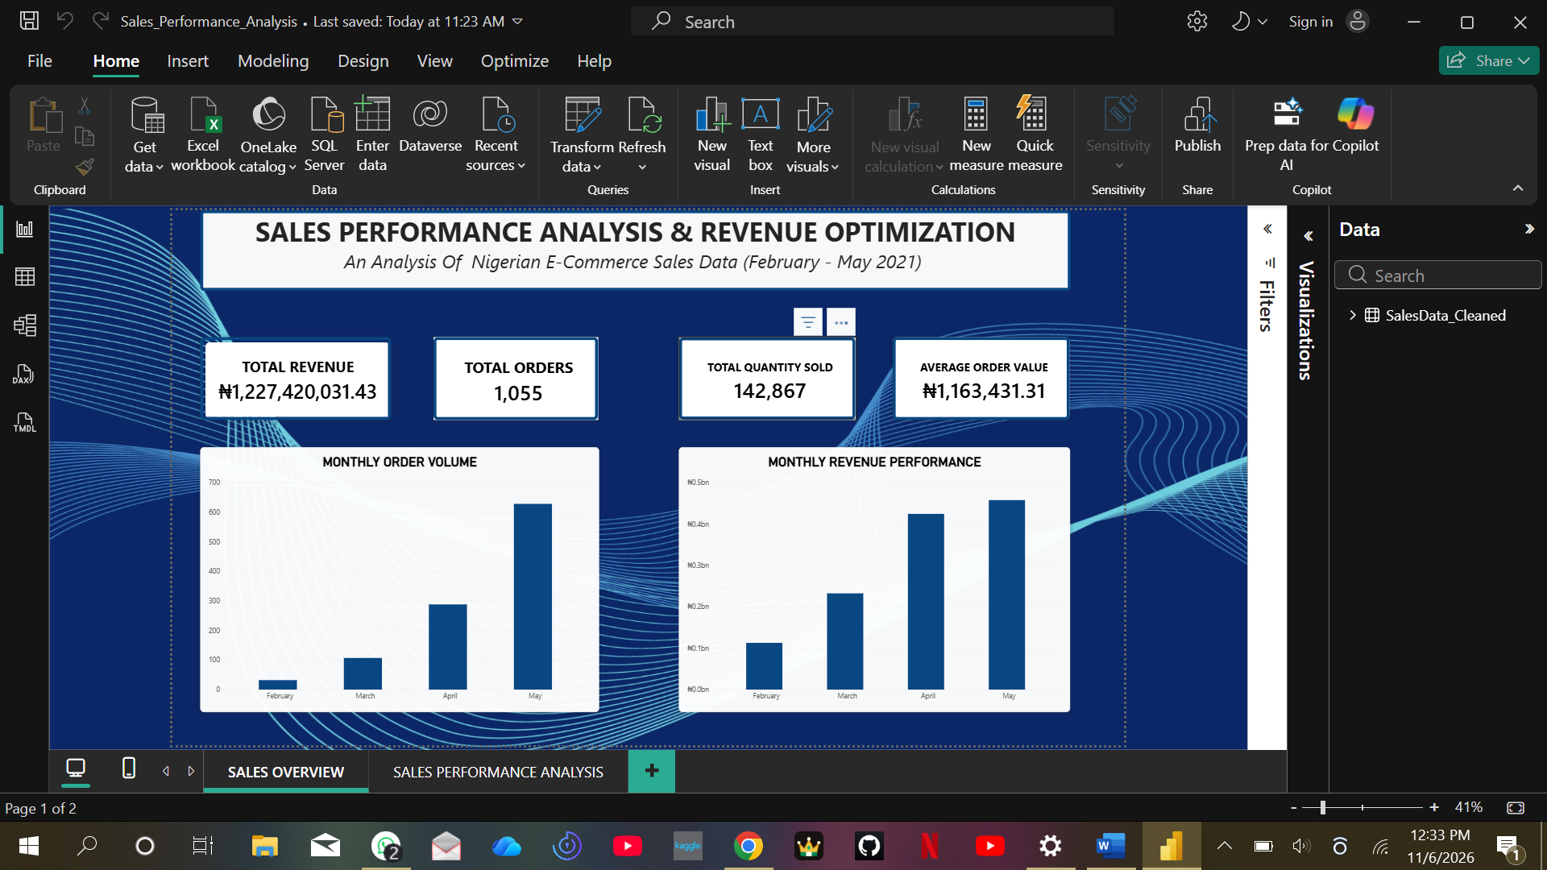
SALES PERFORMANCE DASHBOARD
Connected Power BI to the SQL Server database.
Created four KPI cards to display key performance indicators.
Developed eight visualizations to analyse sales performance.
Presented monthly revenue and order trends.
Compared product, vendor, branch and regional performance.

Slide 8
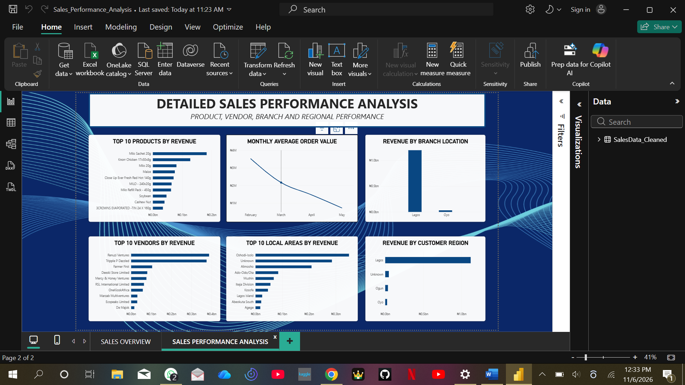
KEY FINDINGS AND RECOMMENDATIONS
Key Findings:
May recorded the highest monthly revenue.
Milo Sachet 20g was the top product by revenue.
Renuzi Ventures recorded the highest vendor revenue.
Lagos generated the highest branch revenue.
Recommendations:
Maintain stock levels for high-performing products.
Monitor vendor performance regularly.
Investigate areas with missing location information.
Use sales reports to support business decisions.

Slide 9
CONCLUSION
The project demonstrated how Excel, SQL Server and Power BI can be used together to analyse sales data and generate useful business insights.

